Slide 1
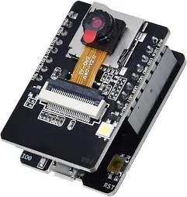
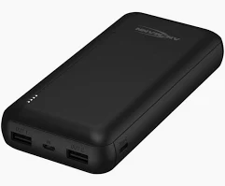




InsectAI Kit-for-kids: Build a Camera Kit
Design a low-cost insect camera system to educate and inspire school groups (age 8-12 years old) with computer vision and insects. Target – available for under €50, and can be built in under 60 min
Team Name _________________________
Team Members:
Your Big Idea: (What makes your kit exciting? Why do kids enjoy building/using it?)
How it works: What happens when it turns on? How do you get data off? What insects do you use it with? Does it use a motion trigger? What sorts of experiments can you do with it?
Parts List - ESP32 Cam - Power Bank - microSD ________________________________________
________________________________________ ________________________________________ ________________________________________ ________________________________________ ________________________________________ ________________________________________
Where is it going to be used (tick all that apply) ☐ School playground ☐ Garden ☐ Farm ☐ Woodland ☐ Other: _______
☐ Other: _______
☐ Other: _______
Who will be able to build it (tick all that apply)
☐ School children (8-12) ☐ School children (12-18) ☐ School children (5-8) ☐ Parents
☐ Teachers ☐ Other: _______
☐ Other: _______
Where does the AI come in? What does it do?
Does it use AI on the device? What does the AI do? Can it identify species? Can it track individuals? Can it count?

Slide 2
Design the classroom experience
How will a teacher use your kit in a 45-minute class?
Lesson title ___________________________________
_____________________________________________
Age group ____________________________________
By the end of the lesson, students will:
Understand: _________________________________
Be able to: __________________________________
Discover: ___________________________________
Sketch your kit in action
Where is the camera? How is it powered? Where are insects? How do kids interact with it? How do they interact with the data? What is the AI doing? What are the children learning?
What one thing will make your kit stand out from the rest?

